Slide 1
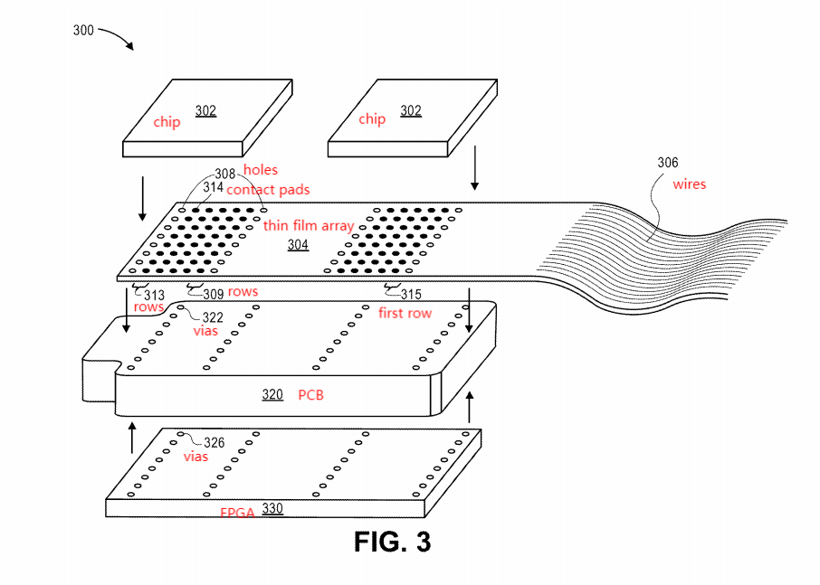
Sandwich Assembly Scheme for Thin Film Electrode Array and Integrated Circuits on Both Sides of Printed Circuit Board (PCB) and Method of Manufacture
Neuralink, US 2021/0008364, 1/14/2021
4/2/2024

Slide 2
Outline
Goal: Sandwich assembly containing a thin film electrode array for use with high density to minimize volume required by associated electronics
Embodiments:
  Top view of thin film electrode array on PCB
  Vertical cross section of electronics package with thin film array + holes aligned with PCB with vias
  Orthogonal projection view of thin electrode array with holes on PCB with vias connecting chips to an FPGA
  Threads and coined contact pads on thin electrode array
  Vertical cross sction of capacitors attached to an electronics package
  Array attach structure
  Flowcharts

Slide 3
Orthogonal projection view of thin electrode array with holes on PCB with vias connecting chips to an FPGA (sandwich assembly view)

Slide 4
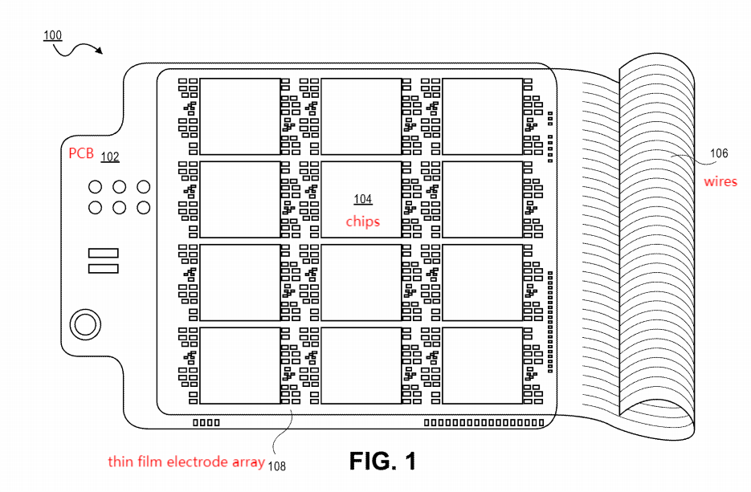
Top view of thin film electrode array on PCB

Slide 5
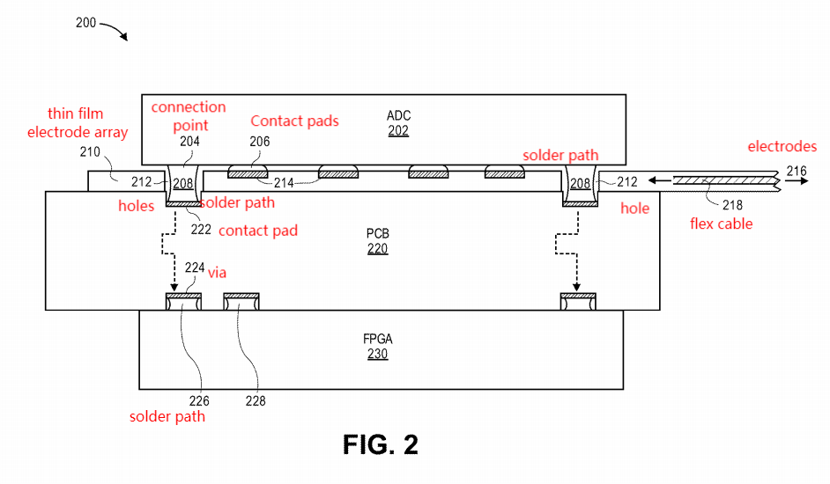
Vertical cross-section of electronics package containing thin film electrode array + holes, aligned with PCB with vias

Slide 6
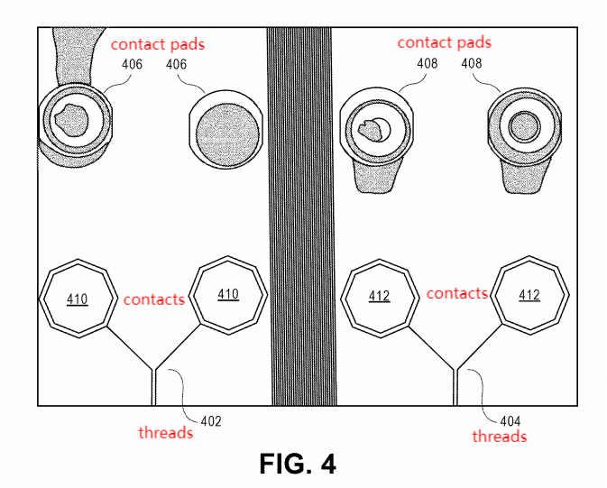
Top view of threads and coined contact pads on thin electrode array

Slide 7
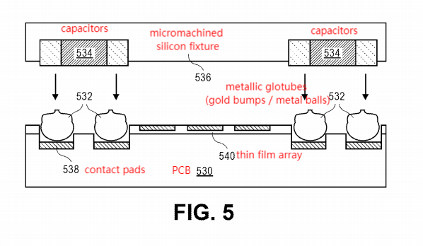
Vertical cross section of capacitors attached to an electronics package

Slide 8
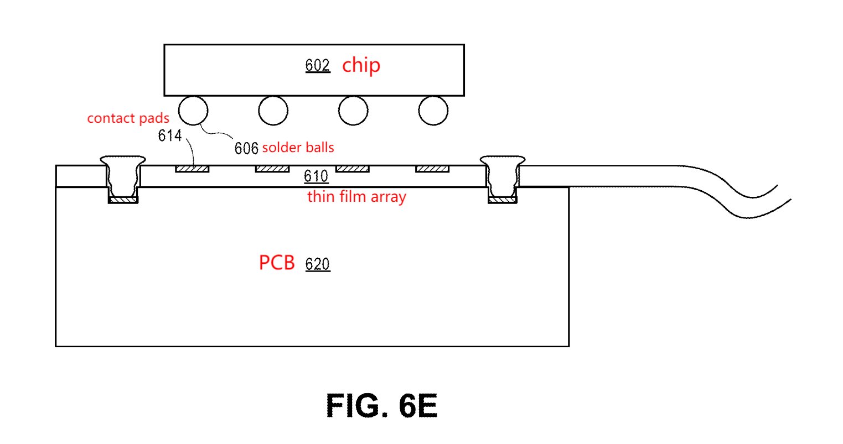
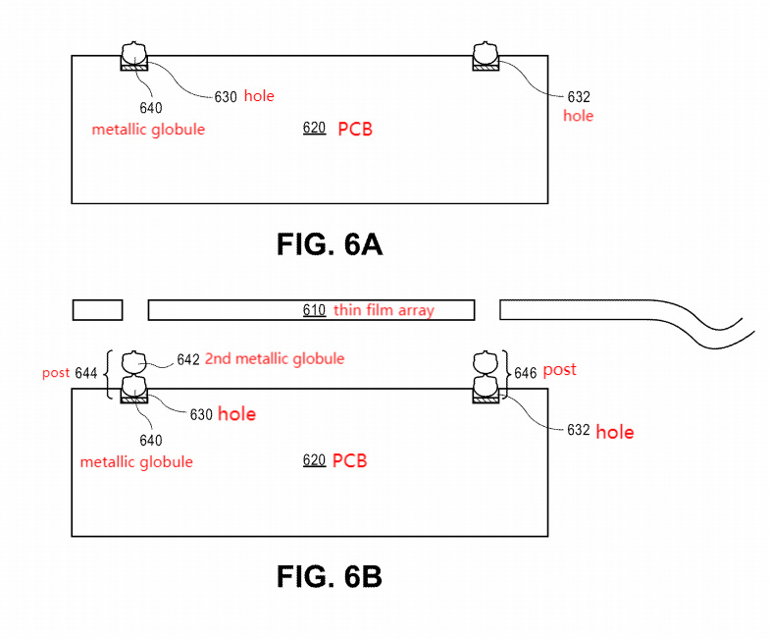
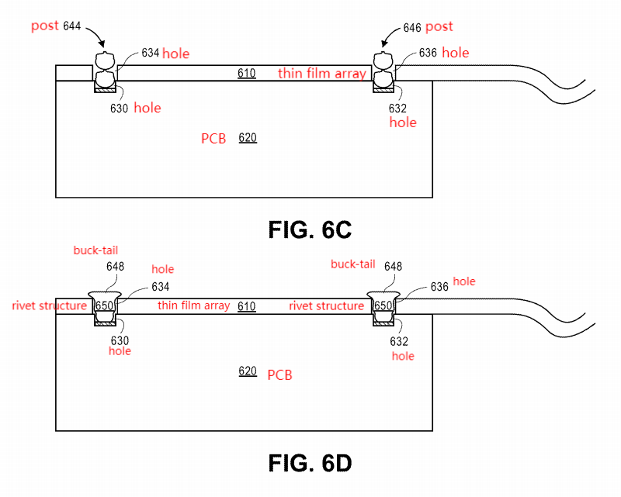
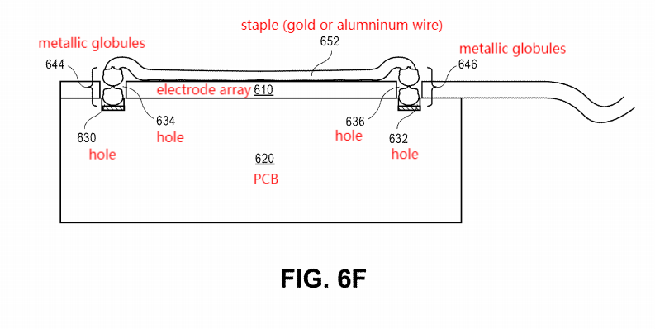
Array Attach Structure for Thin Film Electrode Array

Slide 9
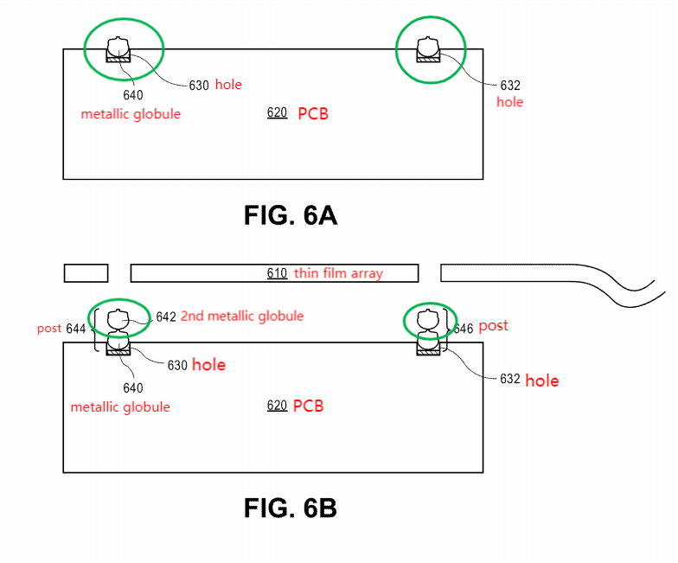
1. Place Metallic Globules for array attach structure

Slide 10
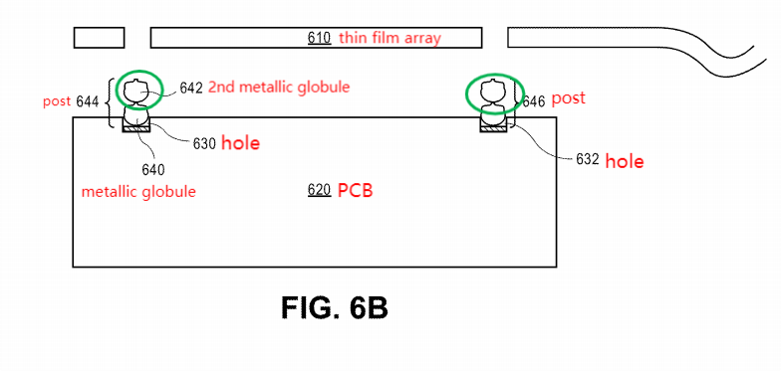
2. Stack metallic globules to form rivet posts for array attach structure

Slide 11
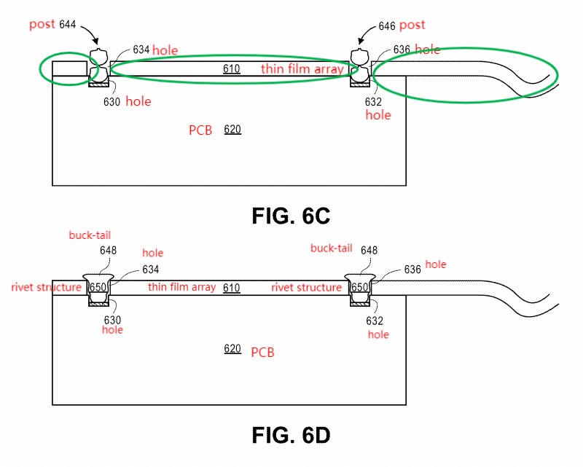
3. Assemble array attach structure

Slide 12
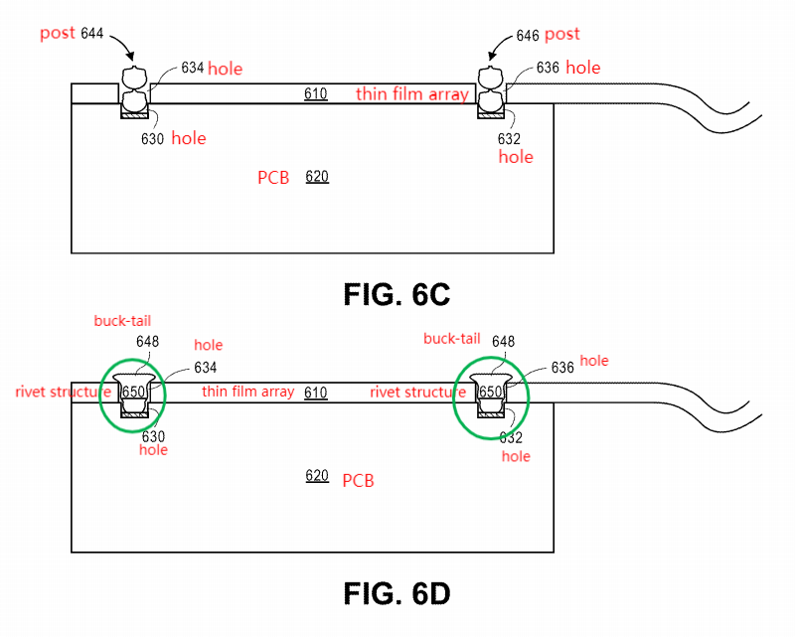
4. Bucking stacked metallic globules to form rivets for array align structure

Slide 13
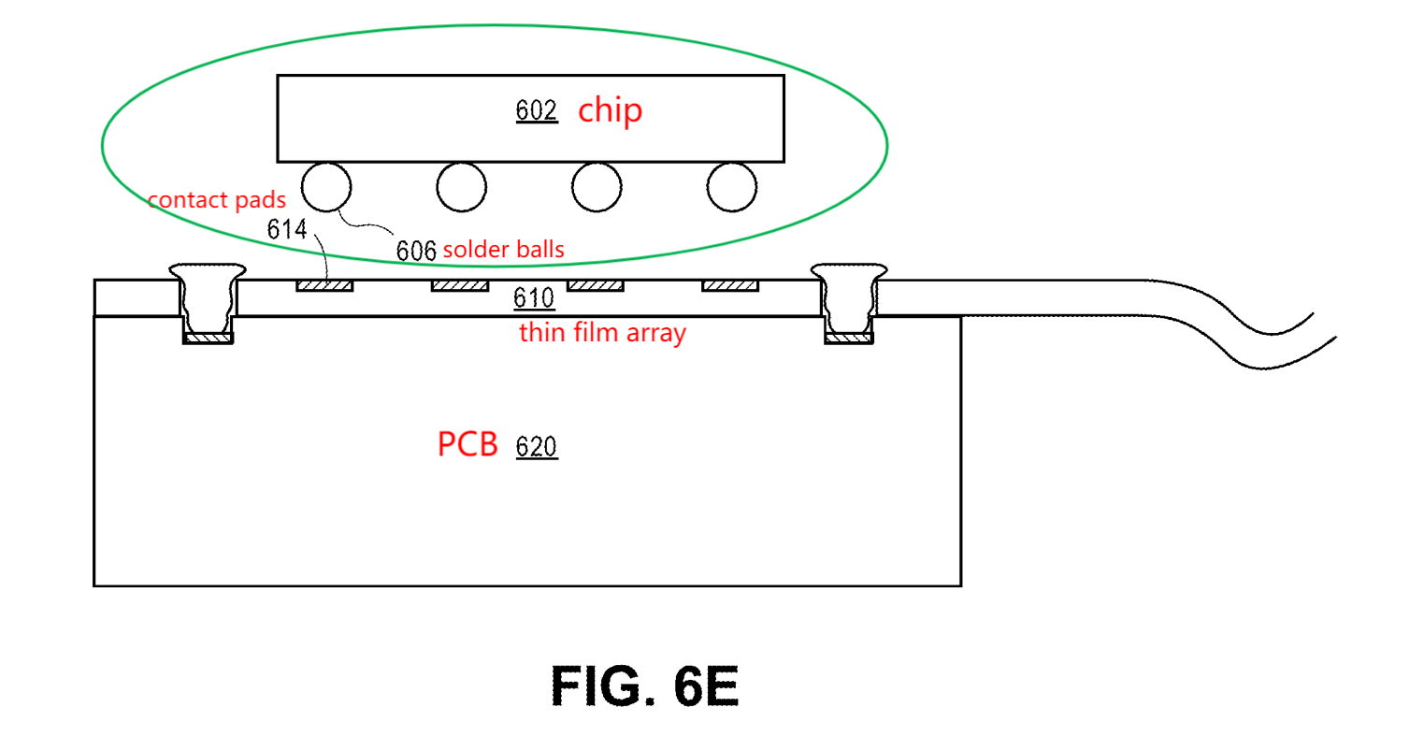
5. Assembling array electronics package including array align structure

Slide 14
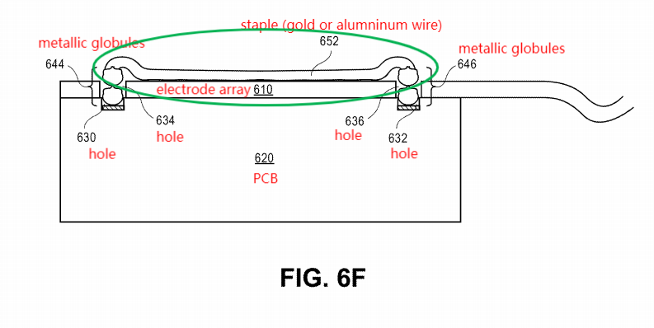
6. Stapling a thin film with stacked metallic globules for array staple structure

Slide 15
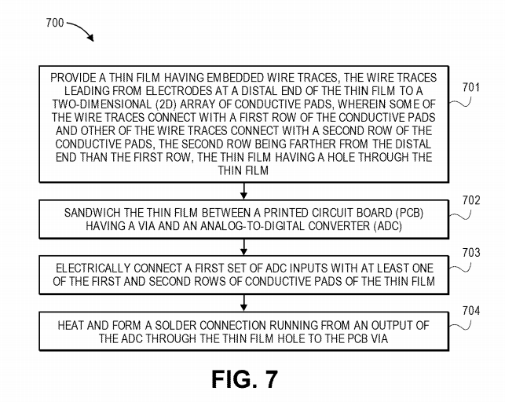
Flowchart

Slide 16
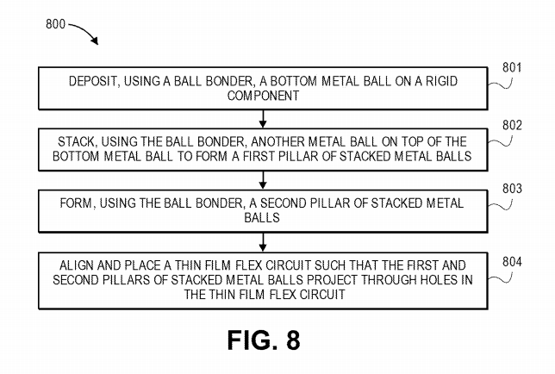
Another flowchart (Almost like figure 6)

